Slide 1

GIT & GITHUB
“From Zero to Real Project Deployment”

Slide 2
INTRODUCTION
Why GitHub Matters:
Version Control: Track changes in your code and manage project history
Collaboration: Work with team members on the same project
Portfolio: Showcase your projects to recruiters and companies

Slide 3
Before Learning GitHub
  We need to understand the difference between
Git and GitHub

Slide 4
What is Git?
Git is a tool used to track changes in files, especially in coding projects. It keeps a record of every change so you can see what was modified and when. Git allows you to go back to previous versions if something goes wrong. It also supports collaboration by allowing multiple people to work on the same project without overwriting each other’s work.
    Developed by Linus Torvalds
    First released in 2005

Slide 5
Example:
Imagine you are writing notes in Google Docs with your friends:
You make changes → edits are saved automatically
You can see previous versions → version history
Many people can edit at the same time → teamwork
Connect to Git:
Git saves every change like Google Docs history
You can go back to old versions anytime
Multiple people can work together without losing data

Slide 6

KEY FEATURES OF GIT
Version Tracking:
Records every change made to your files so you can review or restore any previous version.
Distributed System:
Each user has a complete copy of the project, allowing work even without an internet connection.
Branching & Merging:
You can work on new ideas separately (branch) and later combine them into the main project safely
Collaboration:
Multiple developers can work on the same project without overwriting each other’s work.

Slide 7
What is GITHUB?
GitHub is a cloud-based platform used to store, manage, and share code online. It works with Git to help developers collaborate on projects, track changes, and work together from anywhere. GitHub also allows you to showcase your projects and build your portfolio.
  Founded by Tom Preston-Werner, Chris Wanstrath, PJ Hyett, and Scott Chacon
  Launched in 2008
  Acquired by Microsoft in 2018

Slide 8
Why GitHub is Used
Store Code Online:
Keeps your projects safe and accessible from anywhere
Collaboration:
Multiple people can work on the same project easily
Track Changes:
See what changes were made and when
Backup & Security:
Your code is saved online, so it won’t be lost
Portfolio:
Show your projects to recruiters and companies

Slide 9
Key Features of GitHub
Repositories:
A folder that contains your project files and code.
Commit:
A save point of your work (like saving a file).
Branch:
A separate copy to work on new changes without affecting the main project.
Pull Request:
A request to add your changes to the main project.
GitHub Pages:
Used to create and host a website from your project.

Slide 10
Git vs GitHub
Feature | Git | GitHub
What it is | Tool | Platform (Website)
Meaning | Tracks changes in code | Stores and shares code online
Works on | Your computer (local) | Internet (cloud)
Internet needed | ❌ Not required | ✅ Required
Main use | Version control | Collaboration & backup
Example | Saving versions of files | Sharing project with others

Slide 11
Steps to Push Project to GitHub

Slide 12
Installation & Setup
Step 1: Install Git (Windows)
Go to the official website: https://git-scm.com/install/windows
Click Download for Windows
Open the downloaded file and start installation
  Installation Steps (Keep Default)
  Click Next for most options
  Use default settings (recommended for beginners)
  Click Install
  Click Finish after installation

Slide 13
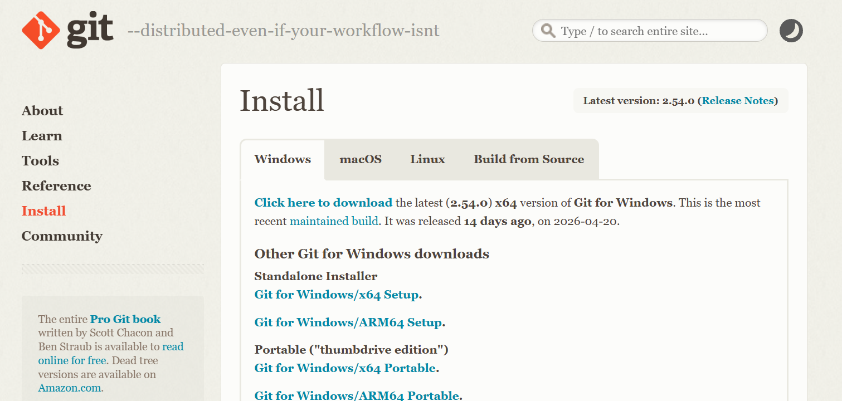

Slide 14
Verify Installation
Open Command Prompt or Git Bash
Type:
git --version
If installed correctly, it will show the Git version

Slide 15
Step 2: Create GitHub Account
Go to the official website : https://github.com
Sign Up Process
    Click Sign up
    Enter your Email address
    Create a Password
    Choose a Username
    Click Continue
Verification
Verify your email (OTP or code) or Complete simple verification (captcha)

Slide 16
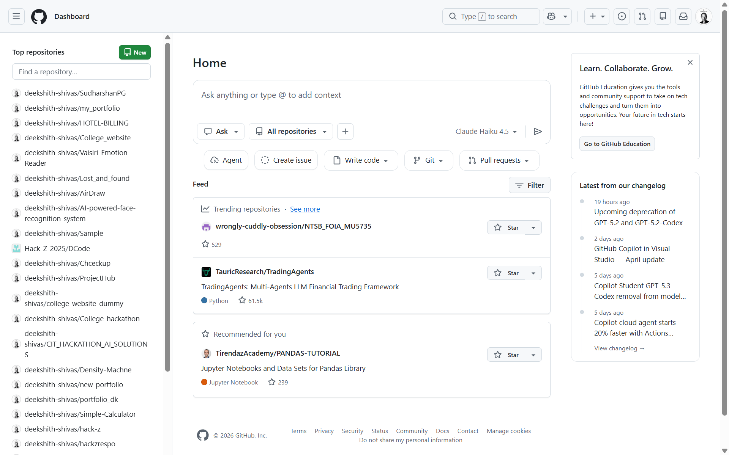
GitHub Dashboard Overview

Slide 17
Step 3: Git Configuration (Meaning & Explanation)
[ open Git Bash or VScode Terminal ]
Git configuration is used to set your identity (name and email) so that Git can record who makes changes in a project.
Commands:
    git config --global user.name "Your Name"
    git config --global user.email your@email.com
These commands tell Git who you are.
Whenever you commit, Git records your name and email with that change.
You need to do this only once (first-time setup)
No need to repeat for every project

Slide 18
Basic Git Commands
git init
  Initializes a new Git repository (starts tracking your project) by creating a hidden .git folder inside your project directory
  This folder stores all history, versions, and tracking data
git add .
  Adds all files and changes to the staging area (a place where changes are prepared before saving (commit).
  “.” means all files in the folder
  It collects all the changes and prepares them to be saved.”

Slide 19
git commit -m "message"
    Saves the changes with a message (creates a version)
    Saves them permanently in Git
    commit = save your work
    -m "message" = short description of what you changed
git status
    Shows the current status of files and changes
    Tells which files are changed
    Shows which files are added (staged)
    hows which files are not yet saved (unstaged)

Slide 20
Step 4: Initialize Git Repository
Command:
git init
Meaning :
      Initializes a new Git repository in your project folder
      Creates a hidden .git folder
      Starts tracking all changes in the project

Slide 21
Option 1: Using VS Code (Direct Method)
Steps:
  Open your project folder in VS Code
  Open Terminal → Terminal → New Terminal
  Run:
  git init
  VS Code terminal automatically opens in your project folder
  No need to use cd
  Git starts tracking immediately

Slide 22
Option 2: Using Git Bash
Steps:
Open Git Bash
Navigate to your project folder:
cd "your-folder-path"
Example:
cd "C:\Users\YourName\Documents\my-project"
Then run: git init
  Git Bash opens in a default location
  You must first go to your project using cd
  Then initialize Git

Slide 23
Step 5: Add Files to Staging Area
Command :
git add .
Meaning :
    Adds all files and changes to the staging area
    Prepares files to be saved (commit)
    “.” means all files in the current folder

Slide 24
Step 6: Commit Changes
Command:
git commit -m “initial commit”
Meaning :
    Saves the staged changes as a new version
    - m → adds a message describing the changes
    Creates a snapshot of your project
This step saves your work permanently in Git

Slide 25
Step 7: Create a Repository on GitHub
Go to GitHub
      Open GitHub
      Login to your account
Create New Repository
      Click “+” (top right corner)
      Select “New repository”
Fill Repository Details
      Repository Name: (e.g., my-project)
      Description: (optional)
      Select Public (for sharing) or Private

Slide 26
Public Repository
A public repository is a project that is accessible and visible to everyone on GitHub.
Private Repository
A private repository is a project that is accessible only to the owner and selected users.
Final Step
    Click Create Repository
    ✔ Your repository is now ready
⚠️ Important Note
    Do NOT add a README file while creating the repository

Slide 27
Step 8: Connect Local Repository to GitHub
Where to Find the Command
  Go to your repository on GitHub
  Click “Code”
  Copy from “Push an existing repository from the command line”
Push Existing Project
  git remote add origin https://github.com/username/my-project.git
  git branch -M main
  git push -u origin main

Slide 28
git remote add origin
    Connects your local project to GitHub
    origin = name given to your GitHub repository
    Stores the repository link for future use
git branch -M main
    Sets your branch name to main
    Ensures your local branch matches GitHub’s default branch
git push -u origin main
    Uploads your project to GitHub
    -u → sets default upstream (so next time you can just use git push)
    Sends code from local → GitHub

Slide 29
PROJECT SUCCESSFULLY UPLOADED
Initialized Git in our project
Added and committed files
Created a repository on GitHub
Connected local project to GitHub
Pushed code successfully
Your project is now live on GitHub
Accessible from anywhere
Ready to share with others

Slide 30
What is README.md?
A README.md file is a document that explains your project.
It provides important information like purpose, usage, and instructions.
Why README is Important:
      Explains what your project does
      Helps others understand your code
      Provides setup and usage instructions
      Improves your project presentation
What to Include in README:
Project Title
Description
Features
Installation Steps
Usage Instructions

Slide 31
Deploy Your Project on GitHub

Slide 32
Deploy Your Project on GitHub
[ Using GitHub Pages ]
Steps:
    Go to your repository on GitHub
    Click Settings
    Go to Pages (left side menu)
    Under Source, select:
      Branch → main
      Folder → / (root)
    Click Save
Result: Your website will be live at: https://username.github.io/repository-name

Slide 33
Getting Code from GitHub

Slide 34
Option 1: Clone Repository
Command :
    git clone https://github.com/username/repository-name.git
What Happens Step-by-Step:
    You run the command
    Git connects to GitHub
    Downloads the repository
    Creates a folder in your system
    Project is ready to use

Slide 35
Example:
Command:
git clone https://github.com/user/my-project.git
Result:
        Folder created → my-project/
        Inside → all files + history
Next:
        Open the folder
        Start editing or running the project

Slide 36
Option 2: Download ZIP
Steps:
    Go to the repository on GitHub
    Click Code button
    Select Download ZIP
    Extract the ZIP file on your computer
    Downloads the project as a ZIP file
    Contains only project files (HTML, CSS, JS, etc.)
    Does NOT include Git history or tracking
    No .git folder is included

Slide 37
Next :
    Files are downloaded as compressed ZIP
    You extract it
    A normal project folder is created
    You can open and use the files
Example:
    Download project → project.zip
    Extract → project/ folder
    Open in VS Code → Start working

Slide 38
Handling File Changes in Git

Slide 39
If You Modify (Edit) Files
File is changed
  Commands:
        git add .
        git commit -m “updated files”
        git status
git push
git status : checks the current state of your project and shows what changes have been made.
It displays modified, new, and deleted files, and indicates what is ready to commit.

Slide 40

If You Add New Files
A new file is created (not tracked by Git)
Check Status:
git status // Shows the file as untracked
Add & Commit:
git add .
git commit -m "added new file“
//Git now starts tracking and saves the file
Push to GitHub:
git push origin main //Uploads the new file to GitHub

Slide 41
If You Delete Files
A file is removed from your project folder
Check Status:
git status //Shows the file as deleted
Add & Commit:
git add .
git commit -m "deleted file"
//Git stages the deletion and saves it as a new version
Push to GitHub:
  git push origin main //The file is also removed from GitHub

Slide 42
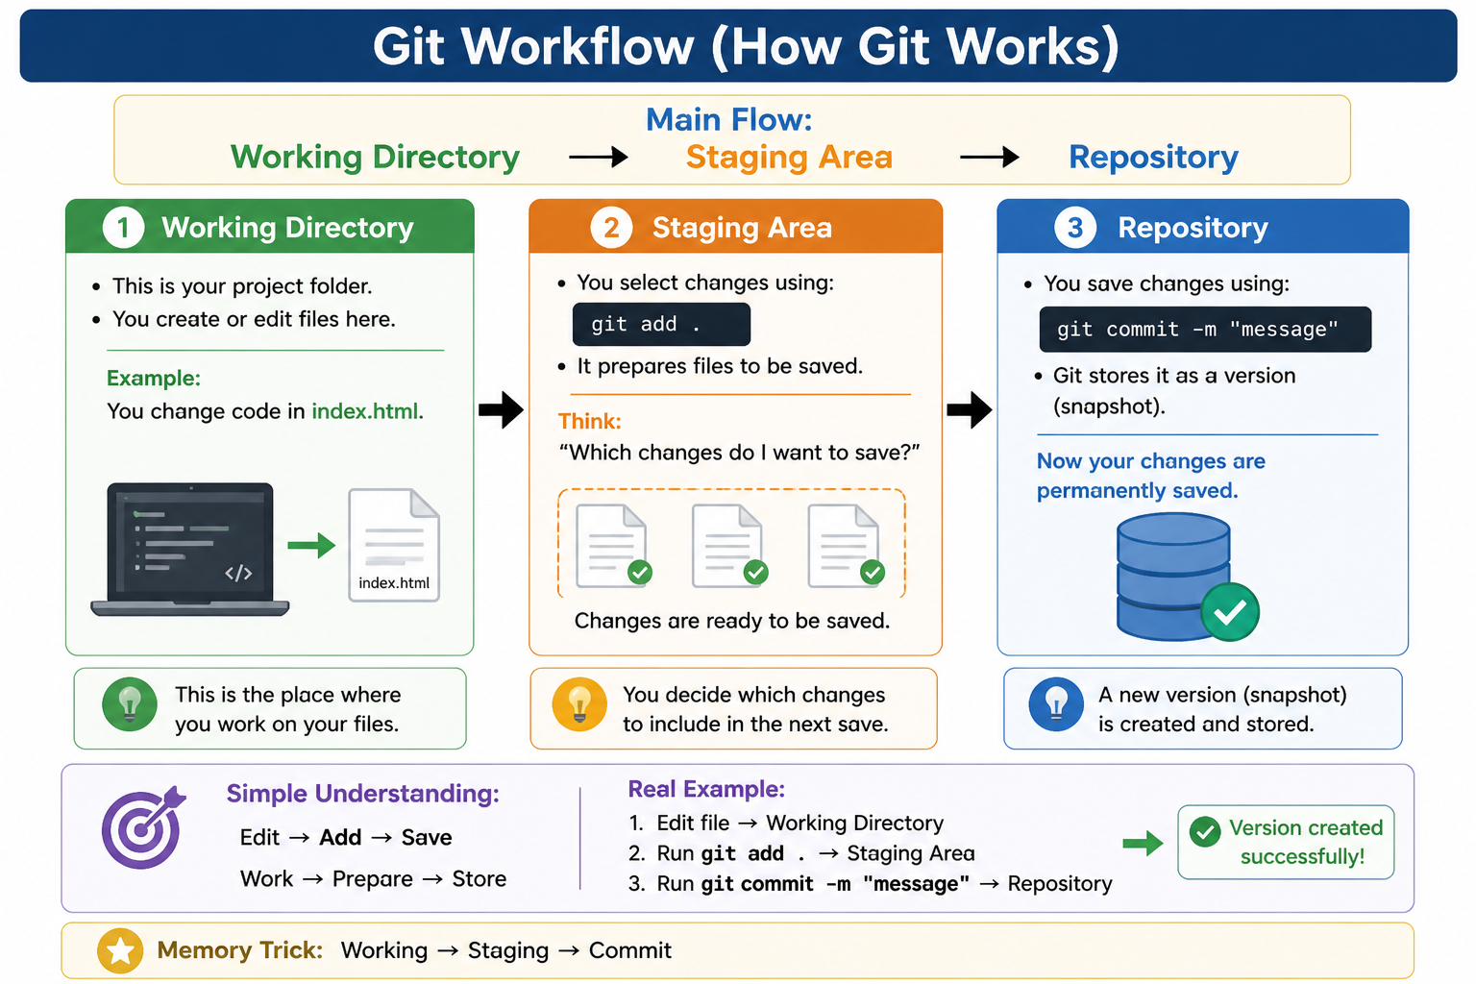

Slide 43
WHAT WE COVERED
Introduction to Git and GitHub
Difference between Git and GitHub
Installation and setup
Basic Git commands (init, add, commit, status)
Creating and pushing a project to GitHub
Cloning and downloading projects
Handling file changes (add, edit, delete)
Deploying project using GitHub Pages

Slide 44
Get This PPT / PDF
  🔗 Download
  https://deeks-github.vercel.app/

Slide 45
💜 Thank You!

